Slide 1

ABALONE AGE PREDICTION USING MACHINE LEARNING
Project Supervisor: Ms. MADHUMITHA, M.E
Name of the Student: ARUNKUMAR V
Register Number: 39110086

Slide 2
Presentation Outline
Course Certificate
Introduction
Objectives
System Architecture / Ideation Map
Project Implementation
Module Implementation
Application Snapshots
Results and Discussions
Conclusion & Future work
References

Slide 3
Course Certificate

Slide 4
Introduction
Abalone:
Abalone is a gastropod mollusk that lives in coastal saltwater. A member of the Haliotidae family, it ranges in size from 4 to 10 inches. Like other univalve snails, it has a single shell on top and uses a large foot to cling to rocks and eat algae. The abalone shell is flat and spiral-shaped with several small holes around the edges.
Random Forest:
Random forest is a Supervised Machine Learning Algorithm that is used widely in Classification and Regression problems. It builds decision trees on different samples and takes their majority vote for classification and average in case of regression.

Slide 5
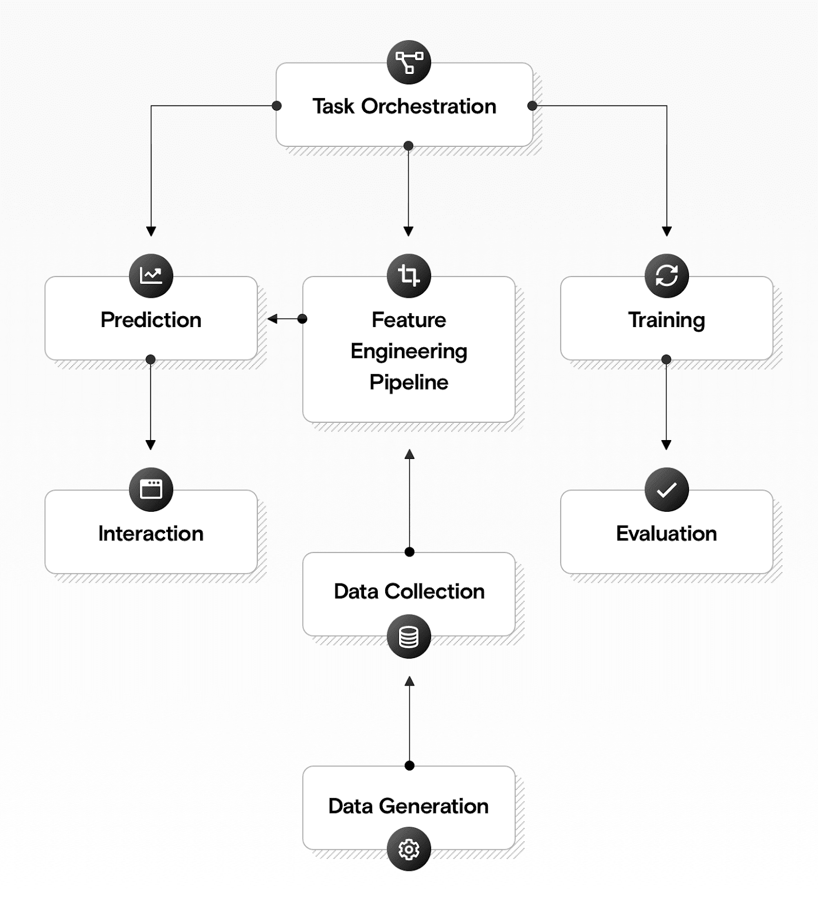
DIAGRAM REPRESENTATION

Slide 6
Objectives
The age of abalone is determined by cutting the shell through the cone, staining it, and counting the number of rings through a microscope -- a boring and time-consuming task.
Other measurements, which are easier to obtain, are used to predict the age.
The main objective is to determine the age of Abalone from the physical measurements.

Slide 7
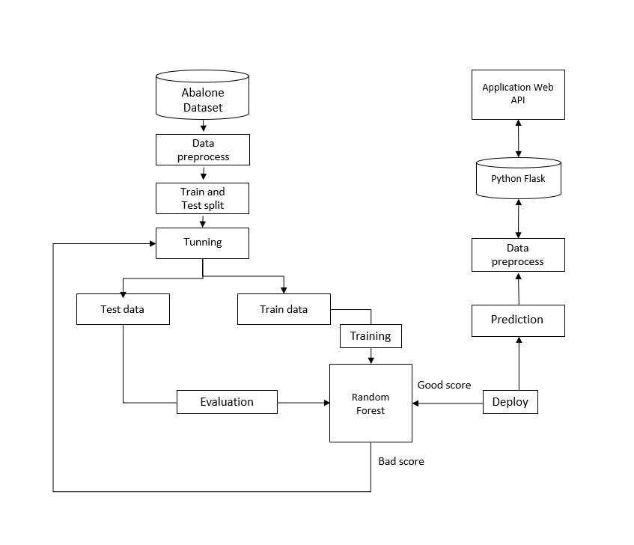
System Architecture

Slide 8
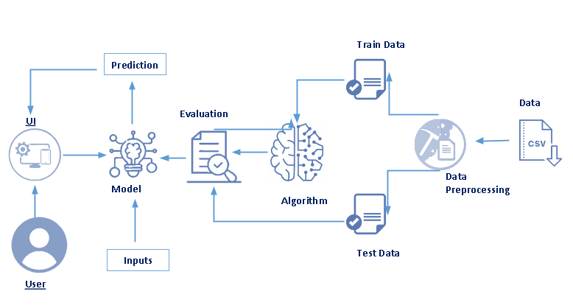
System Architecture

Slide 9
Required Libraries
import numpy as np
import pandas as pd
import matplotlib.pyplot as plt
import seaborn as sns
import warnings
warnings.filterwarnings("ignore")
from sklearn.preprocessing import LabelEncoder
from sklearn.metrics import mean_squared_error
from scipy import stats
from sklearn.model_selection import train_test_split
from sklearn.ensemble import RandomForestRegressor
import pickle
%matplotlib inline
13 November 2021
Department of CSE

Slide 10
Module Implementation
EDA and Data preprocess:
Getting the dataset.
Checking and analysis dataset.
Cleaning the noise data.
Visualize the data.
Feature Analysis.
Random Forest:
Create a machine learning model.
Set the baseline model that you want to achieve
Train the data machine learning model.
Provide an insight into the model with test data
Now compare the performance metrics of both the test data and the predicted data from the evalution.model.

Slide 11
Hardware and Software Requirements
Hardware Requirements:
RAM: A minimum of 16 GB is required
CPU: Processors above Intel Corei7 7th Generation is advised
Storage: A minimum of 1TB HDD is required
Operating System: Linux or Windows or Mac
Software Requirements:
conda v4. 8.3
Python 3.7 or Python 3.8
Jupyter Notebook v4.8
Google Chorme v100.0.4896.75

Slide 12
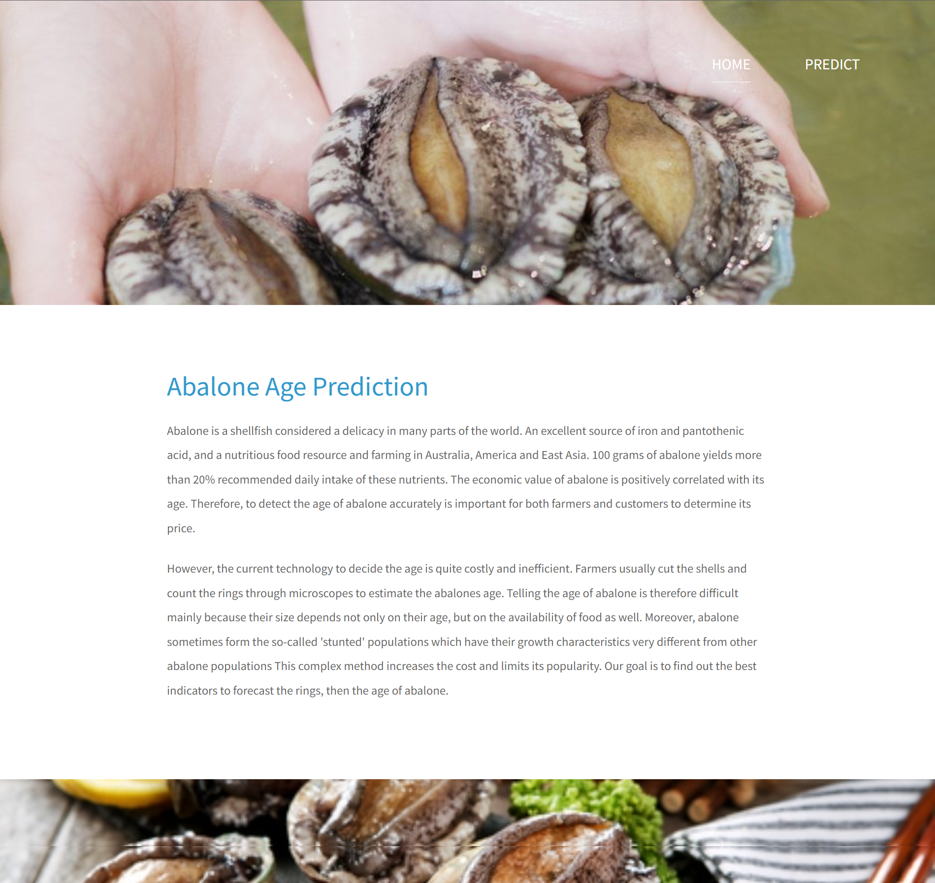
Application Screenshot

Slide 13
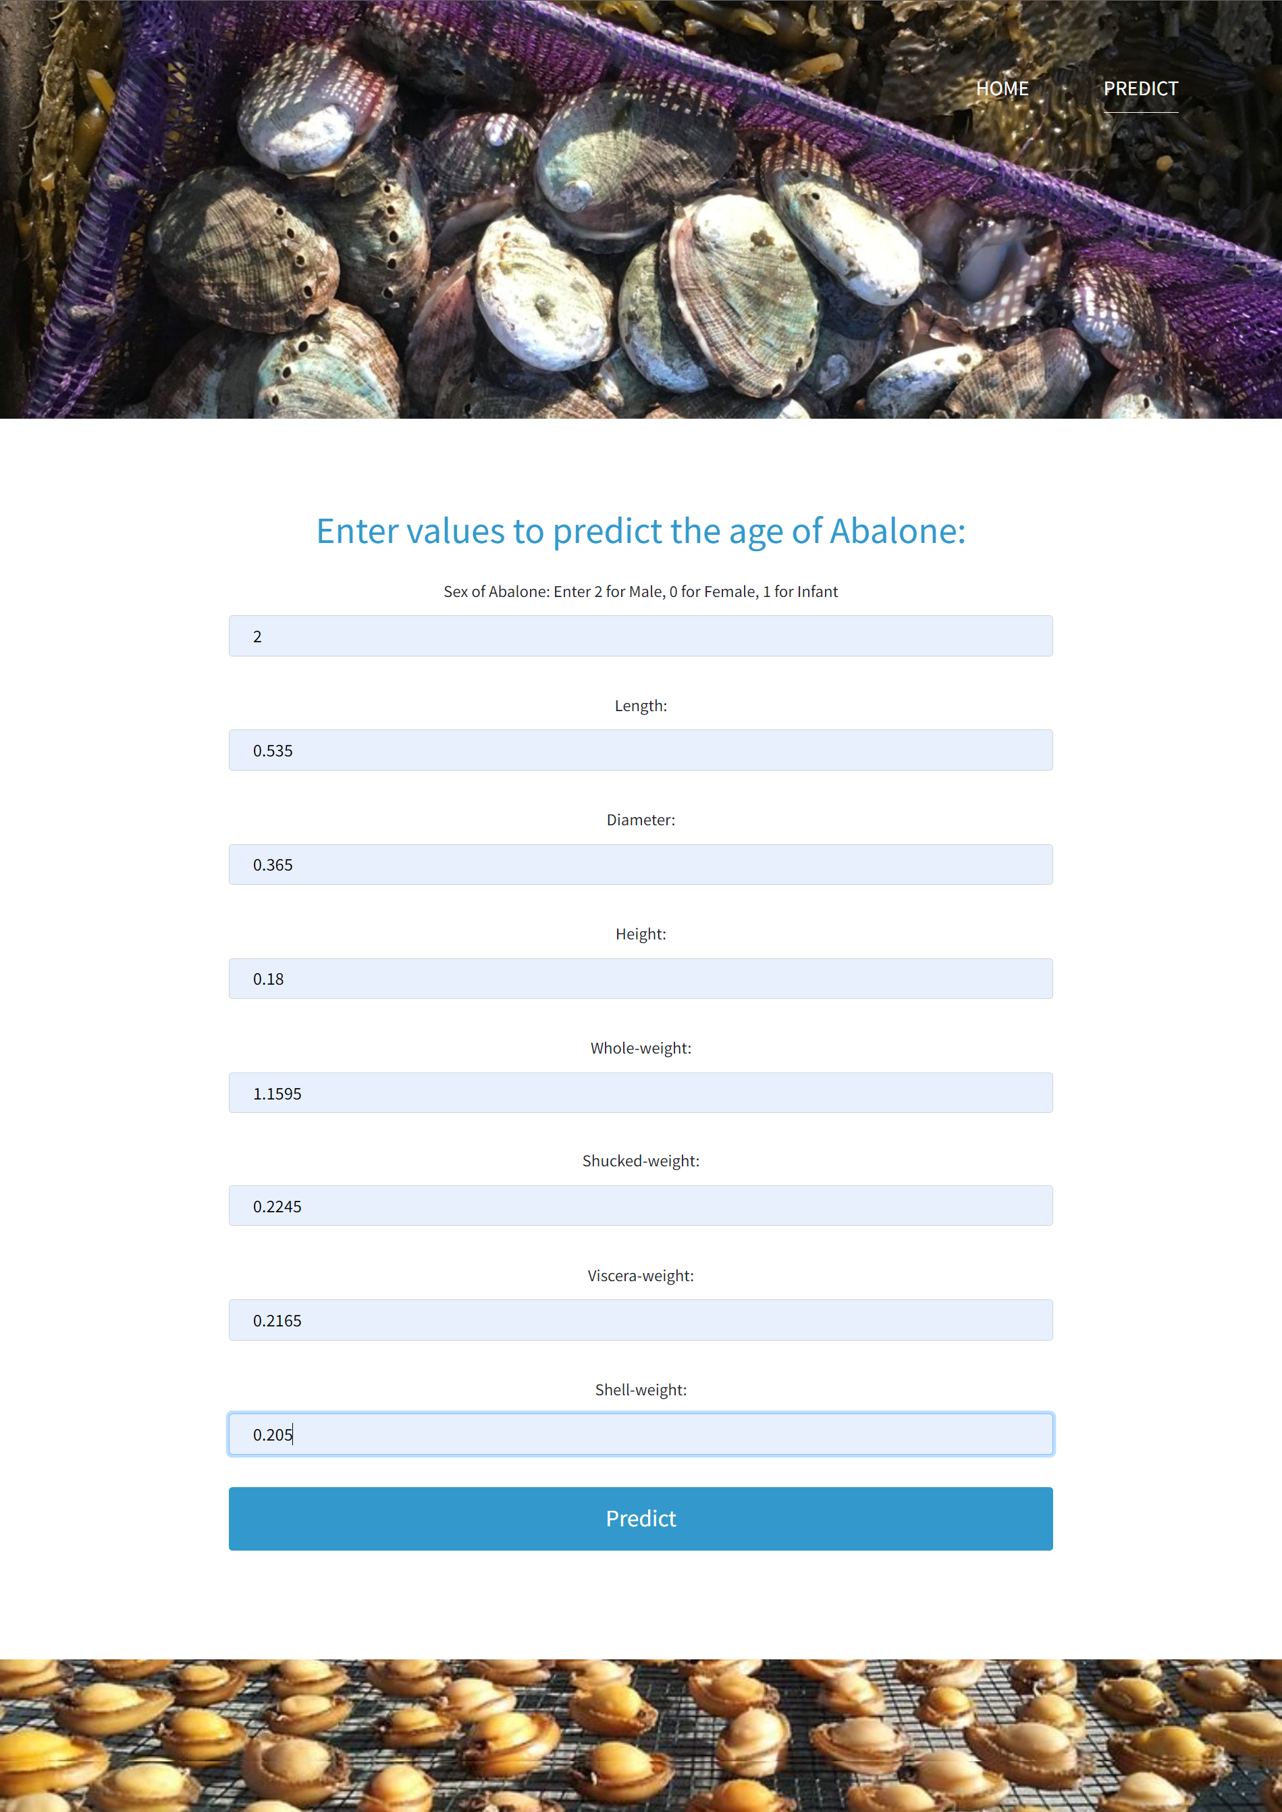
Application Screenshot

Slide 14
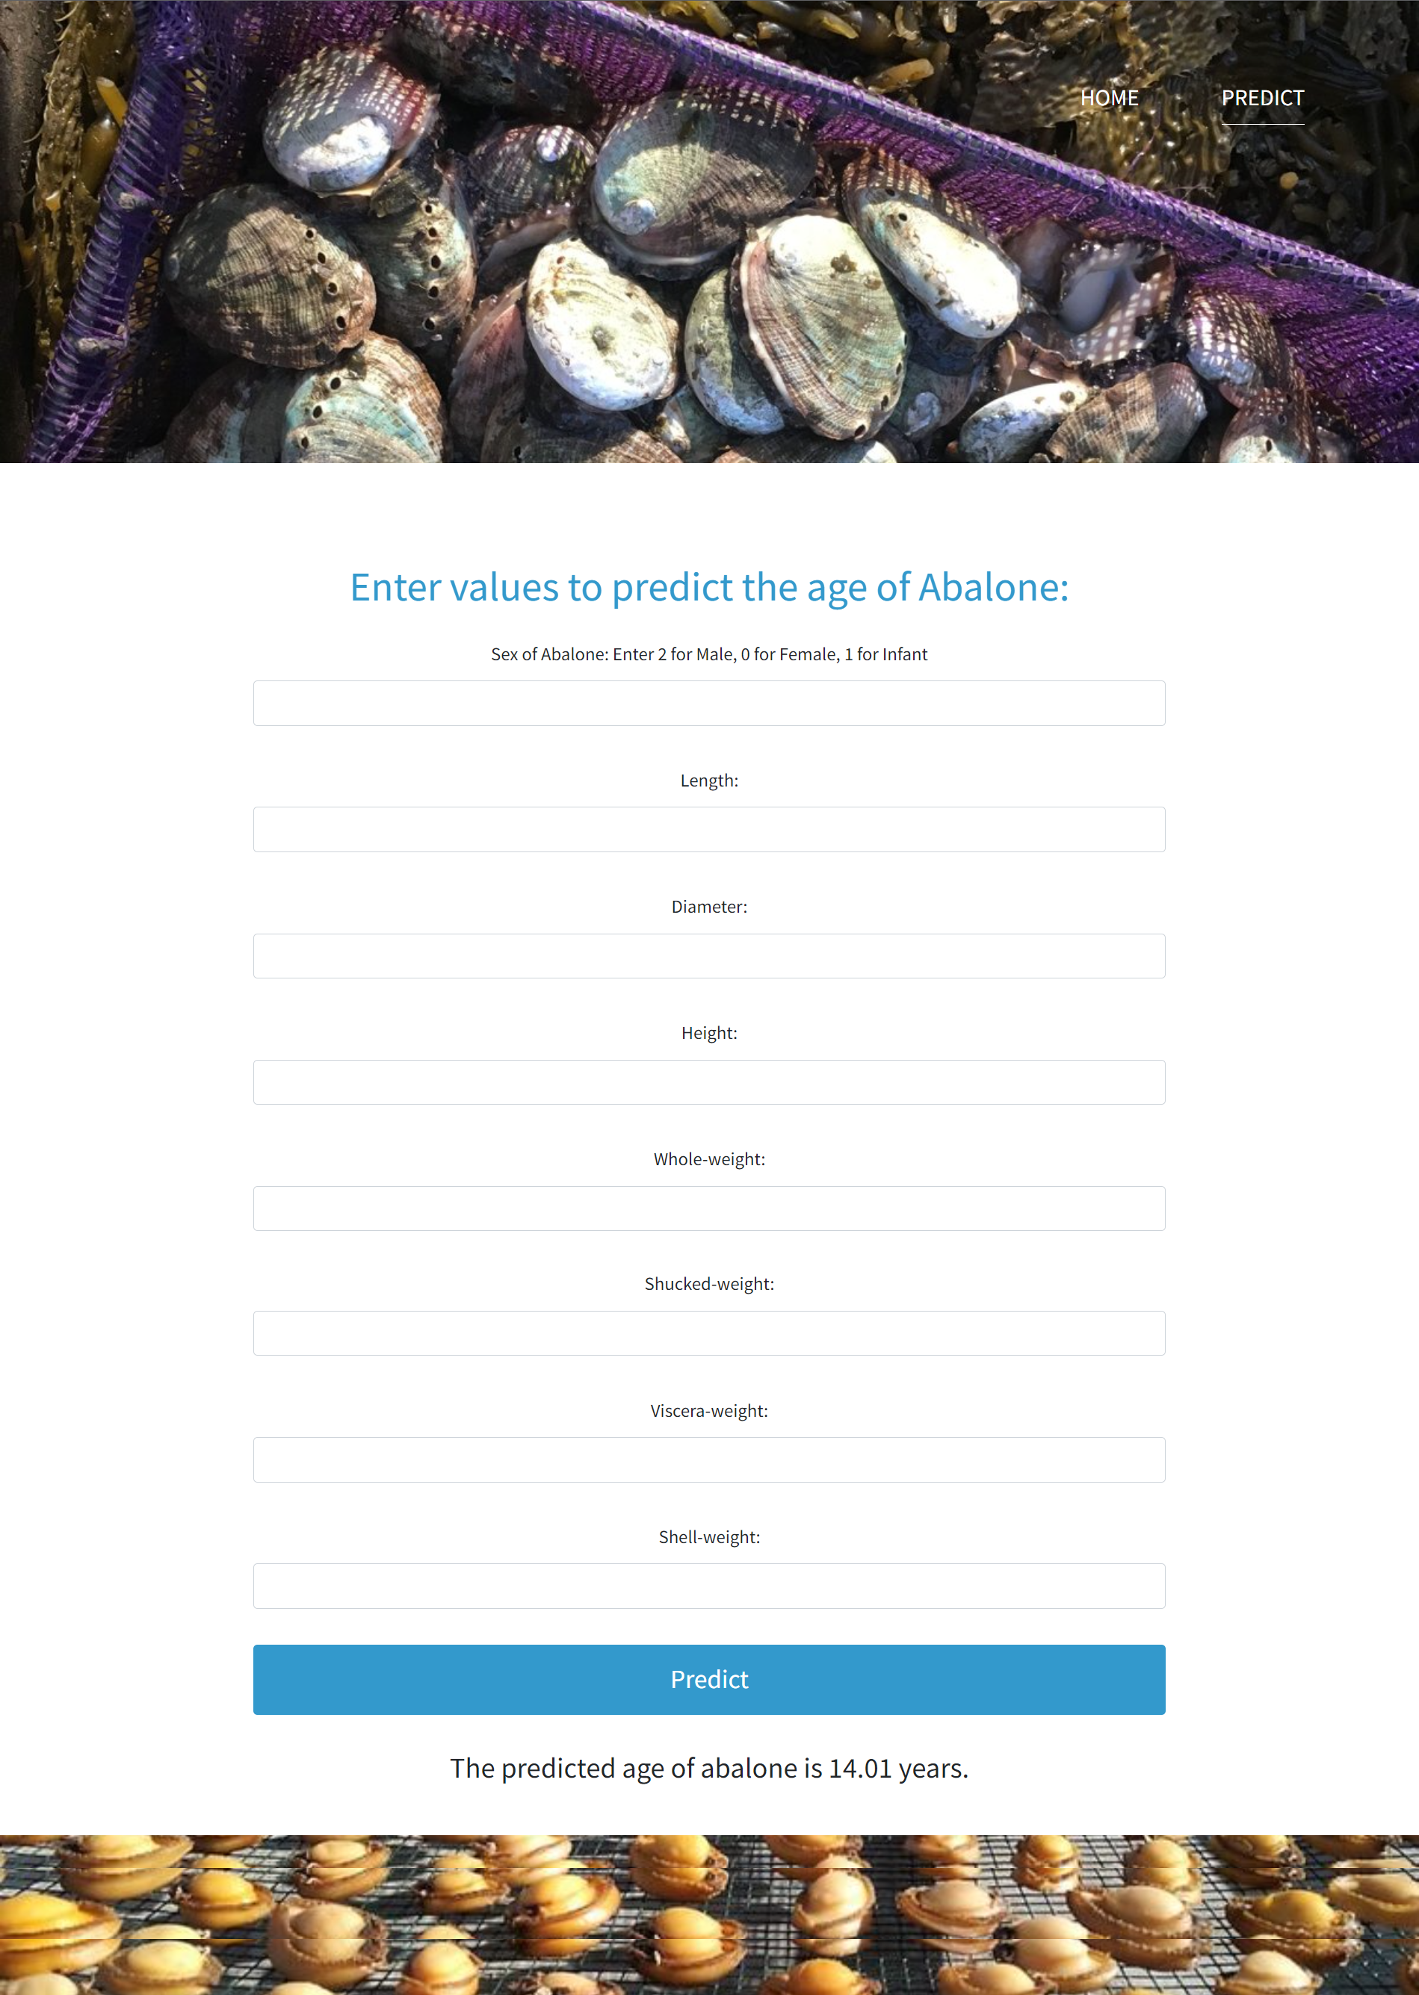
Application Screenshot

Slide 15
Results and Discussion
This interface consists of different fields that user has to give the physical measurements of abalone.
If the user enters all the physical values of abalone and click on submit button then it predicts the age of abalone.
Variable within the dataset can be related for lots of reasons. For example, one variable could cause or depend on the values of another variable or one variable could be lightly associated with another variable or two variables could depend on a third unknown variable.

Slide 16
Conclusion and Future work
On the source of this study it appears the future regression systems effort well to forecast the age of abalone.
The study directs that we do not prerequisite to count the quantity of rings consuming microscopic test.
In other disputes, we do not need any laboratory experiment to predict the age of abalones. We can predict the age and price of abalone using the very simple physical individualities like weight, height, diameter, and length.

Slide 17
References
[1] Abalone. http://en.wikipedia.org/wiki/Abalone.
[2] UCI Machine Learning Repository: Abalone Dataset. http://archive.ics.uci.edu/ml/datasets/Abalone.
[3] Al-Daoud, E. (2009). A comparison between three neural network models for classification problems. Journal of artificial intelligence, 2(2), 56-64.
[4] Bretos, M. (1980). Age determination in the keyhole limpet Fissurella crassa Lamarck (Archaeogastropoda: Fissurellidae), based on shell growth rings. The Biological Bulletin, 159(3), 606-612.
[5] Clark, D., Schreter, Z., & Adams, A. (1996, April). A quantitative comparison of dystal and backpropagation. In Australian Conference on Neural Networks.

Slide 18
References
[6] Day, R. W., Williams, M. C., & Hawkes, G. P. (1995). A comparison of fluorochromes for marking abalone shells. Marine and Freshwater Research, 46(3), 599-605.
[7] Gurney, L. J., Mundy, C., & Porteus, M. C. (2005). Determining age and growth of abalone using stable oxygen isotopes: a tool for fisheries management. Fisheries Research, 72(2-3), 353- 360.
[8] Naylor, J. R., Manighetti, B. M., Neil, H. L., & Kim, S. W. (2007). Validated estimation of growth and age in the New Zealand abalone Haliotis iris using stable oxygen isotopes. Marine and freshwater research, 58(4), 354-362.
[9] Siddeek, M. S. M., & Johnson, D. W. (1997). Growth parameter estimates for Omani abalone (Haliotis mariae, Wood 1828) using length-frequency data. Fisheries research, 31(3), 169-188.
[10] Takami, H., Oshino, A., Sasaki, R., Fukazawa, H., & Kawamura, T. (2006). Age determination and estimation of larval period in field caught abalone (Haliotis discus hannai Ino 1953) larvae and newly metamorphosed post-larvae by counts of radular teeth rows. Journal of experimental marine biology and ecology, 328(2), 289-301.

